Slide 1

Red Hat System Administration I 10.0
Chapter 5
Dilara Gülenç

Slide 2
RHEL Lightspeed: AI-Powered Enterprise Assistance
Core Foundation: Combines decades of Red Hat Enterprise Linux domain expertise with modern AI technologies.
Target Audience: System administrators, platform engineers, and developers across all experience levels (from beginners to seasoned admins).
Strategic Value: Shifts resource allocation from routine maintenance to innovation through proactive guidance, knowledge, and recommendations.
Subscription Model: Included directly within the standard Red Hat Enterprise Linux subscription at no extra licensing cost.
1. Command-Line Assistant (Lesson Focus):
  Enables natural English-language questions directly inside the terminal.
  Delivers instant answers, CLI command suggestions, and troubleshooting workflows.
2. Red Hat Insights Image Builder Recommendations:
  Context-aware package suggestions early in the build pipeline.
  Reduces configuration risk by proactively identifying missing dependencies and components.

Slide 3
The Command-Line Assistant in RHEL 10
Role & Interface | User Experience Benefits | Core Objectives
Terminal Integration: Interprets natural English-language queries directly at the shell prompt without context switching. | Dual Advantage: • Newer Admins: Simplifies complex administrative workflows and syntax. • Seasoned Admins: Accelerates lookup speed and boosts operational efficiency. | Practical Focus: Troubleshoot real-world system issues by formulating effective technical prompts and critically evaluating assistant output.

Slide 4
RHEL Lightspeed Command-Line Assistant
Nature: An optional generative AI tool engineered to boost administrator productivity directly from the terminal.
Contextual Help: Interprets natural English queries to generate commands, syntax examples, troubleshooting guidance, and answers.
Key Use Cases:
  Answering RHEL-specific configuration and usage questions.
  Assisting with systematic system troubleshooting.
  Interpreting and explaining system log entries.
  Eliminating manual searches across external documentation.
Deployment Model: Supported initially as a connected experience only (requires active internet access to function).
Future Roadmap: Red Hat is actively investigating methods to support disconnected, on-premise deployments.

Slide 5
Operational Boundaries & Safety Guidelines
Generative AI Verification | System Privacy & Telemetry Boundary
Output Nature: • As a generative AI model, output is generally beneficial but may occasionally be incomplete or inaccurate. | No Local System Inspection: • The assistant cannot inspect or access private hardware/system state information on the host machine.
Mandatory Rule: • Always review and validate AI-generated commands prior to execution. | Operational Behavior: • It cannot tell you your active RAM usage directly; instead, it provides the command you need to run (e.g., free -m) to inspect available memory yourself.

Slide 6
Model Architecture & Foundation
Underlying Model: Powered by the IBM watsonx AI API large language model (LLM) using the IBM Granite foundation model.
Delivery Mechanism: Hosted externally and delivered as a Software-as-a-Service (SaaS) solution.
Availability: Accessible to all registered and subscribed RHEL systems.
Red Hat Ecosystem Datasets: The model is specifically fine-tuned and trained on authoritative enterprise sources:
Red Hat Knowledge Center Service (KCS) articles
Official RHEL system documentation and product guides
Upstream enterprise Linux best practices

Slide 7
Installation & First Query Execution
Prerequisites & Package Deployment:
Parameter | Requirement
Subscription State | System must be actively subscribed (managed via subscription-manager)
Supported Releases | RHEL 10.0 and RHEL 9.6 (or later)
Package Name | command-line-assistant (installed using dnf)
CLI Binary | Provides the c utility as the primary interface

Slide 8
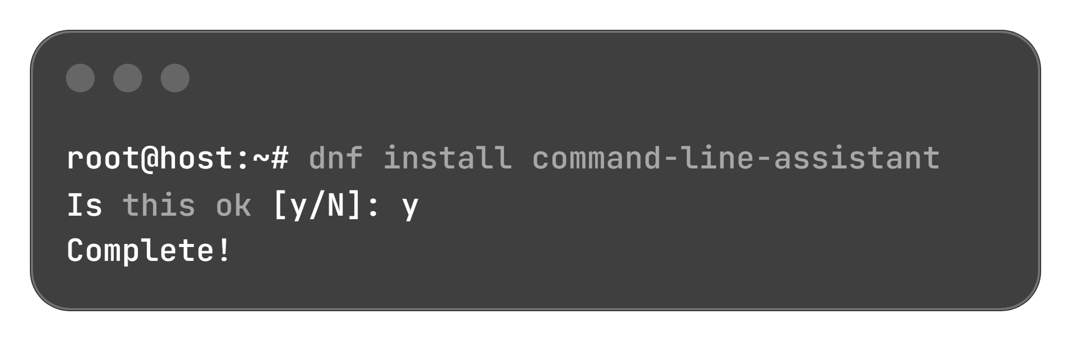
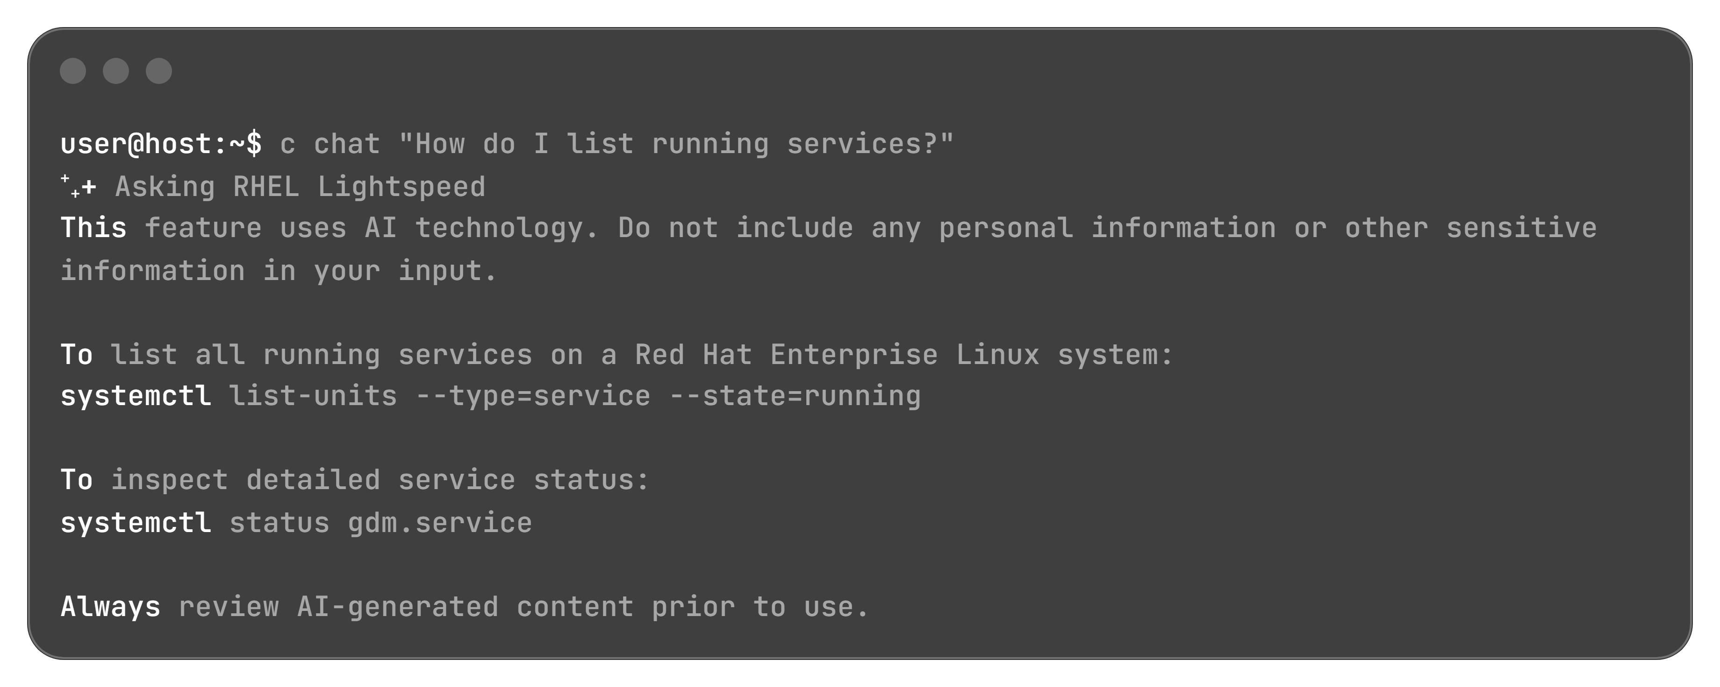
Installation & First Query Execution
Prerequisites & Package Deployment:
1. Package Installation:
2. Querying RHEL Lightspeed (c chat):
Data Privacy Notice: Queries should never contain sensitive or personal data, as interactions may be utilized to improve Red Hat services.

Slide 9
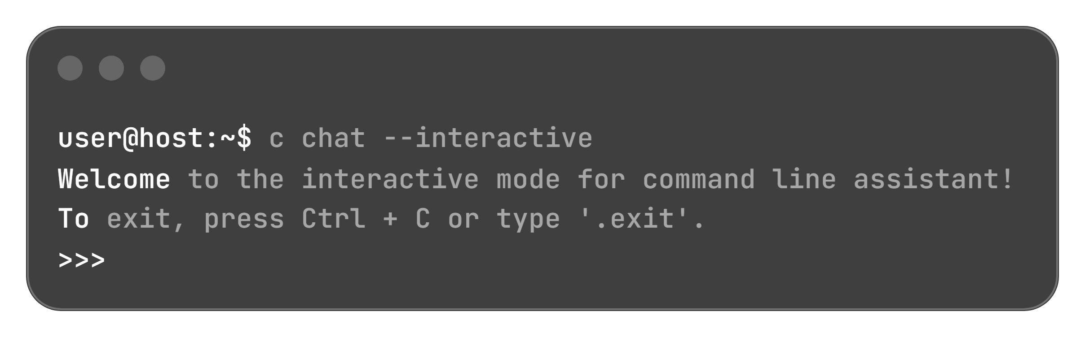
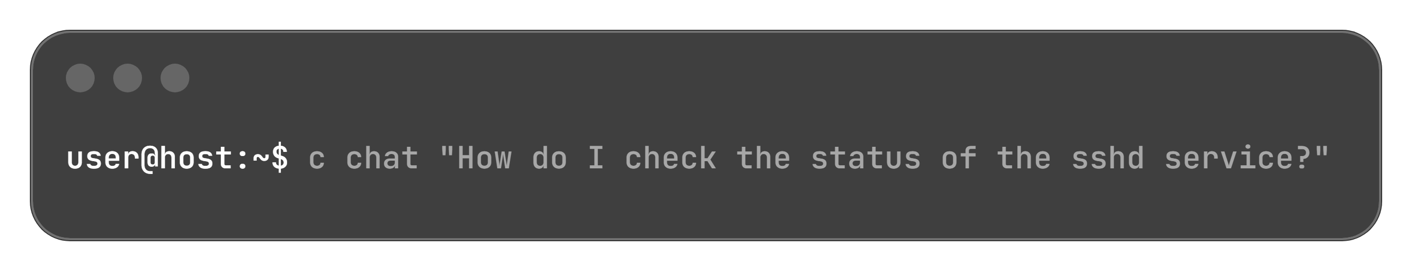
Troubleshooting & Query Modes with RHEL Lightspeed
Use Case: Complex troubleshooting scenarios requiring iterative context, multi-step problem solving, and follow-up clarifications.
Session Lifecycle:
Prompting Principle: Clear, well-structured, and precisely phrased natural-language questions yield the most relevant troubleshooting responses.
Target Audience: Aids users with limited Linux experience while accelerating diagnostic workflows for seasoned administrators.
Direct Natural-Language Query:
Exit Controls: Type .exit or press Ctrl + C to terminate the interactive session.

Slide 10
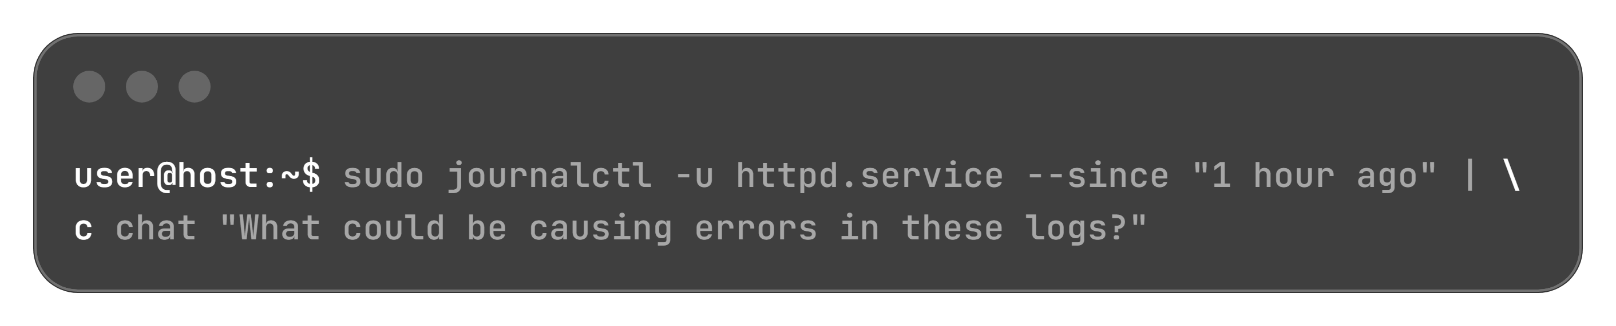
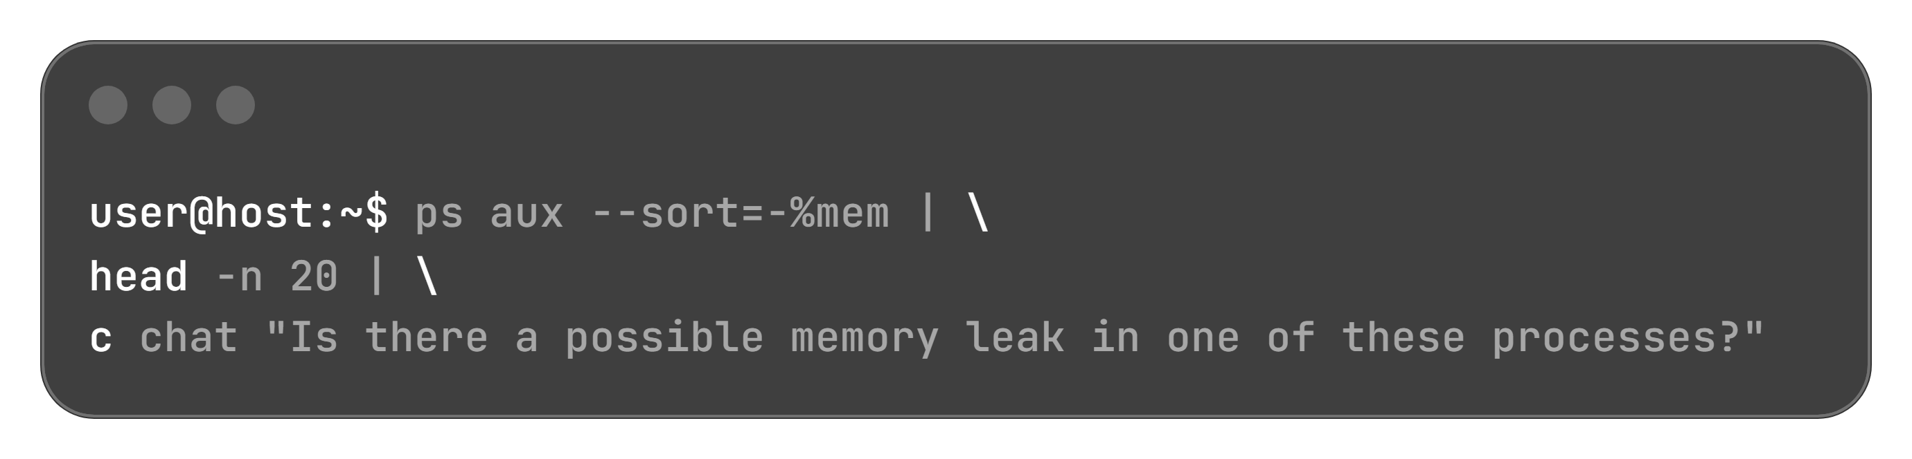
Analyzing Live Command Output via Pipelines
Contextual Analysis: Piping command output directly into the assistant provides concrete operational data for root-cause diagnosis.
HTTP Server Log Inspection:
Resource Profiling: Pipe process inspection tools (ps, top, smem) to detect abnormal consumption patterns.
Top Memory Consumers Inspection:

Slide 11
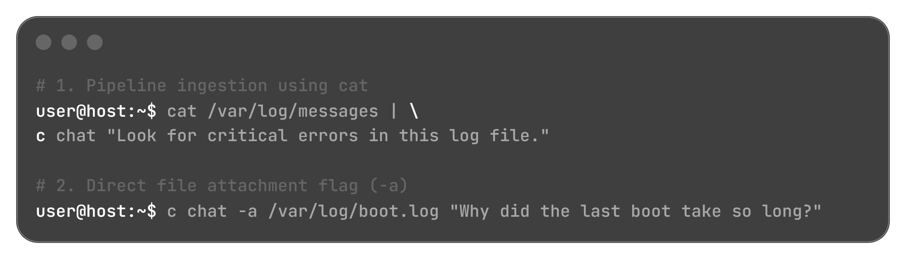
Ingesting File Data: Pipes vs. Direct Attachments
Method | Mechanism | Typical Scenario
Pipeline Ingestion (|) | Streams standard output of file reading utilities (cat) into c chat | Inspecting system log files or active configs
Direct Attachment (-a / --attachment) | Attaches file directly to the query string | Specific system logs, boot logs, and static traces
Execution Examples:
Data Privacy & System Access Boundary: The command-line assistant never accesses local files or system data autonomously; data is analyzed only when explicitly provided or attached by the user.

Slide 12

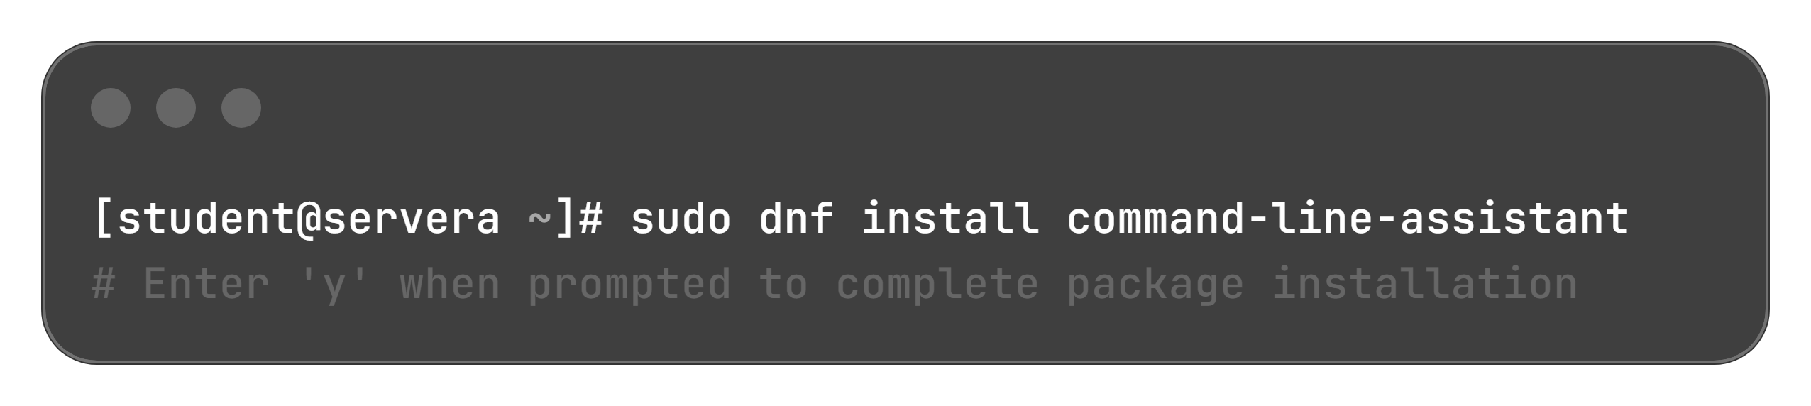
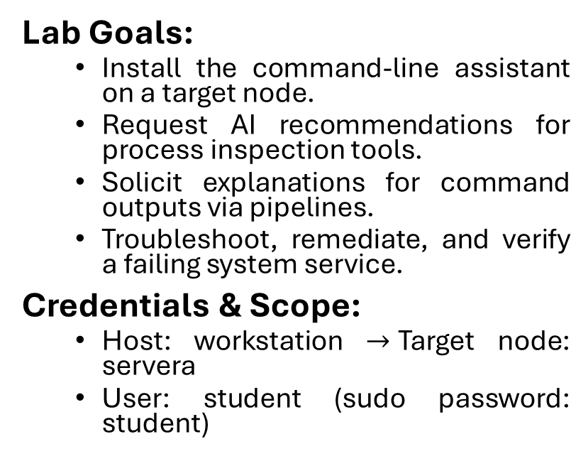
Lab Overview: RHEL Lightspeed Command-Line Assistant
Lab Goals:
  Install the command-line assistant on a target node.
  Request AI recommendations for process inspection tools.
  Solicit explanations for command outputs via pipelines.
  Troubleshoot, remediate, and verify a failing system service.
Credentials & Scope:
  Host: workstation $→$Target node: servera
  User: student (sudo password: student)
1. Start Lab Environment:
2. Install Command-Line Assistant:
Execution Utility: Deploys the c CLI command as the primary user interface.

Slide 13
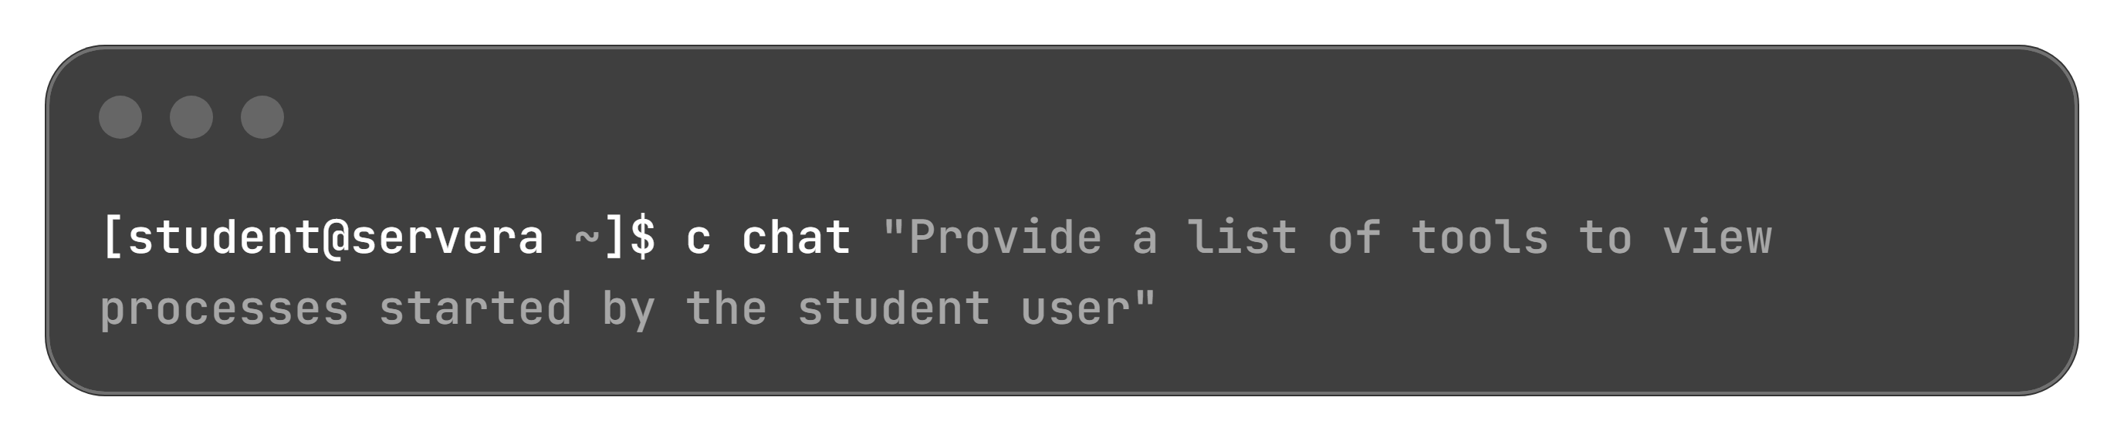
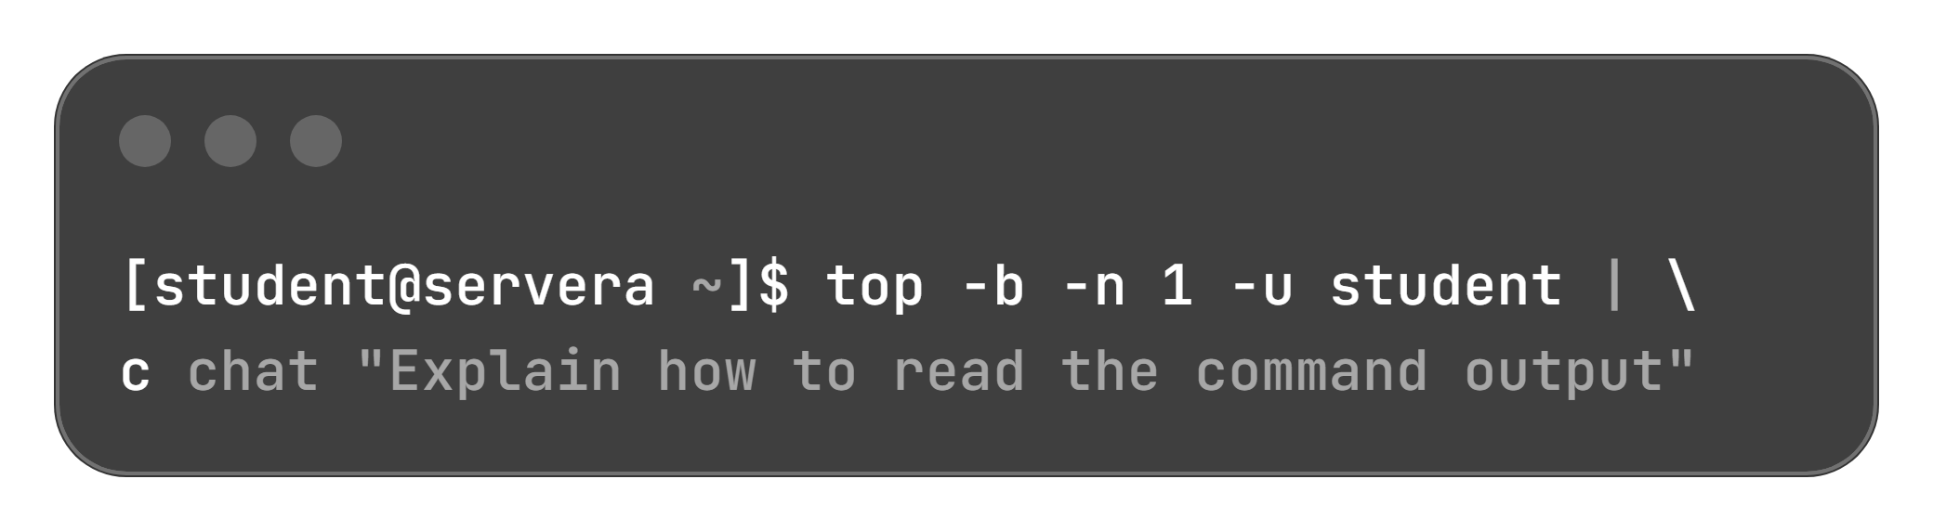
Tool Discovery & Command Output Interpretation
Interactive Natural Language Prompt:
Pipeline Execution:
Assistant Guidance Summary:
ps -u student: Lists processes filtered by specific username.
top / htop: Dynamic real-time process viewers (filter via field selection or user switches).
pidstat -u student: Historical/interval tracking via the sysstat package.
journalctl: Evaluates service-level logs filtered by user attributes.
AI-Assisted Field Breakdown:
Uptime & Load: Displays operational duration and 1/5/15-minute system load averages.
Task & CPU States: Analyzes total tasks, process states (running, sleeping, zombie), and CPU % (us, sy, id, wa).
Memory & Swap: Identifies used, free, buffer/cache allocations, and available RAM.
Process Metrics Table: Translates column headers (PID, PR, NI, VIRT, RES, SHR, S, %CPU, %MEM, TIME+).

Slide 14
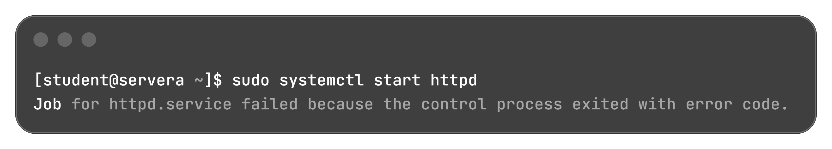
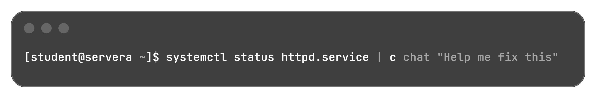
Service Troubleshooting & Diagnosis
Service Start Failure:
Initiating the Apache HTTP server yields a control process execution failure:
Diagnosing via Status Pipeline:

Slide 15
Service Troubleshooting & Diagnosis
AI Evaluation Findings & Decision:
Diagnostic Finding | Root Cause Details | Resolution Path
Unset Environment Variable | OPTIONS evaluated to an empty string | Optional configuration parameter; secondary priority
Configuration Syntax Error | Invalid directive: Lislisten (misspelled) | Primary Failure Cause: Configuration parser rejects invalid directive; requires editing /etc/httpd/conf/httpd.conf

Slide 16
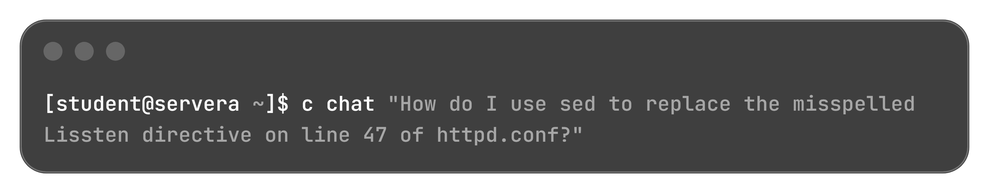
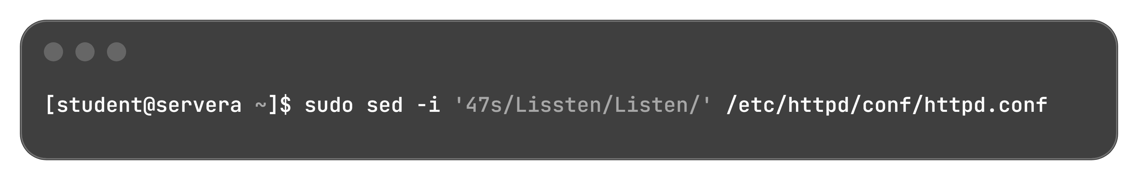
AI Remediation, Verification & Lab Teardown
Querying In-Place Solution:
Assistant Command Recommendation:
-i: In-place file modification.
47s/Lissten/Listen/: Targets line 47 directly to correct the directive syntax:

Slide 17
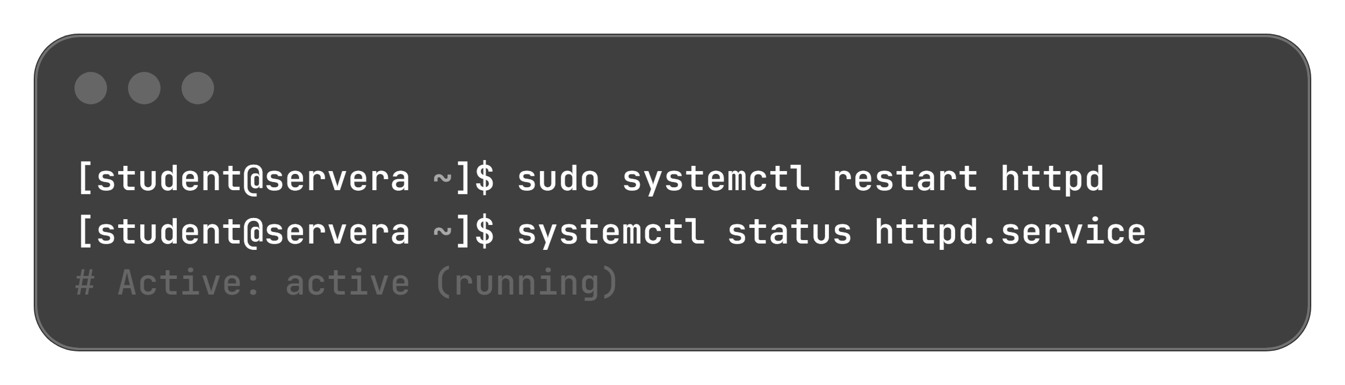
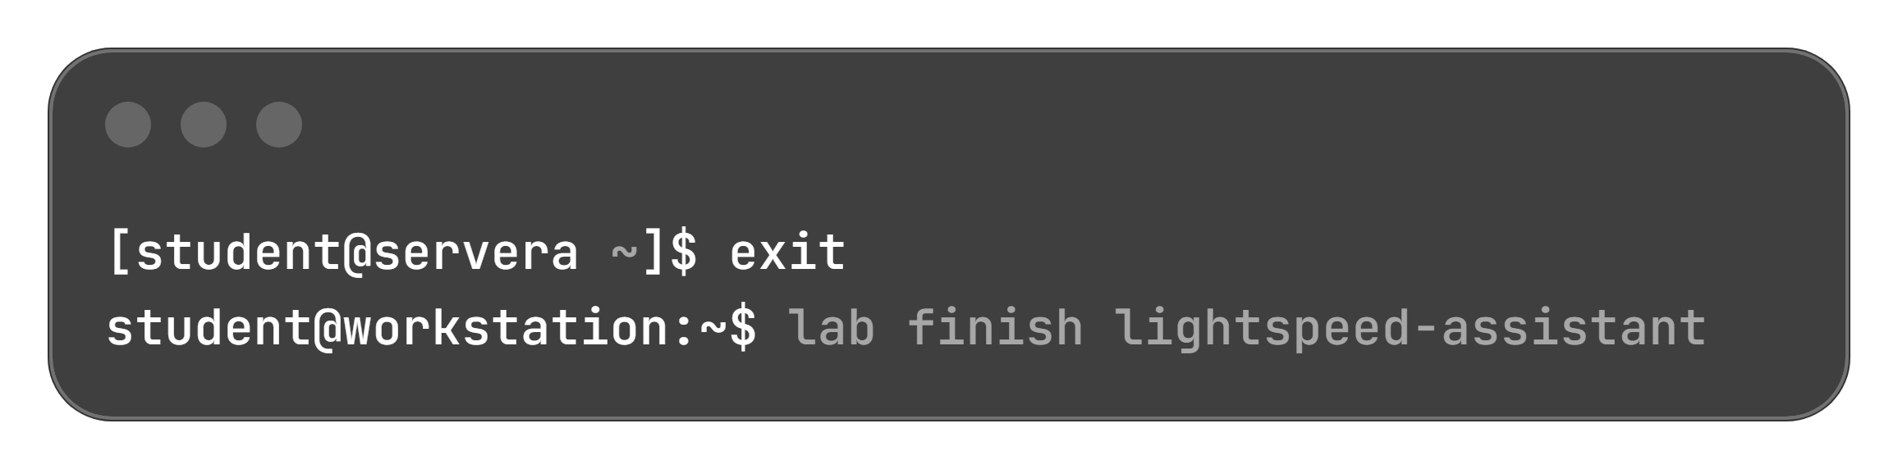
AI Remediation, Verification & Lab Teardown
1. Restart & Verify Service:
2. Disconnect & Teardown:

